Slide 1
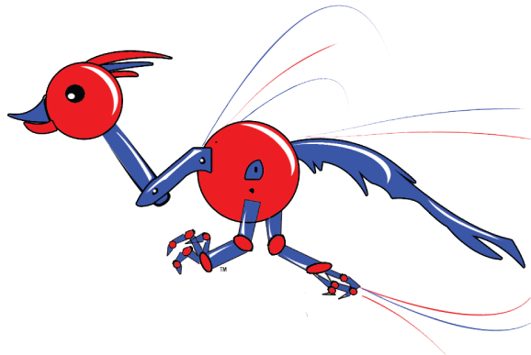


Slide 2
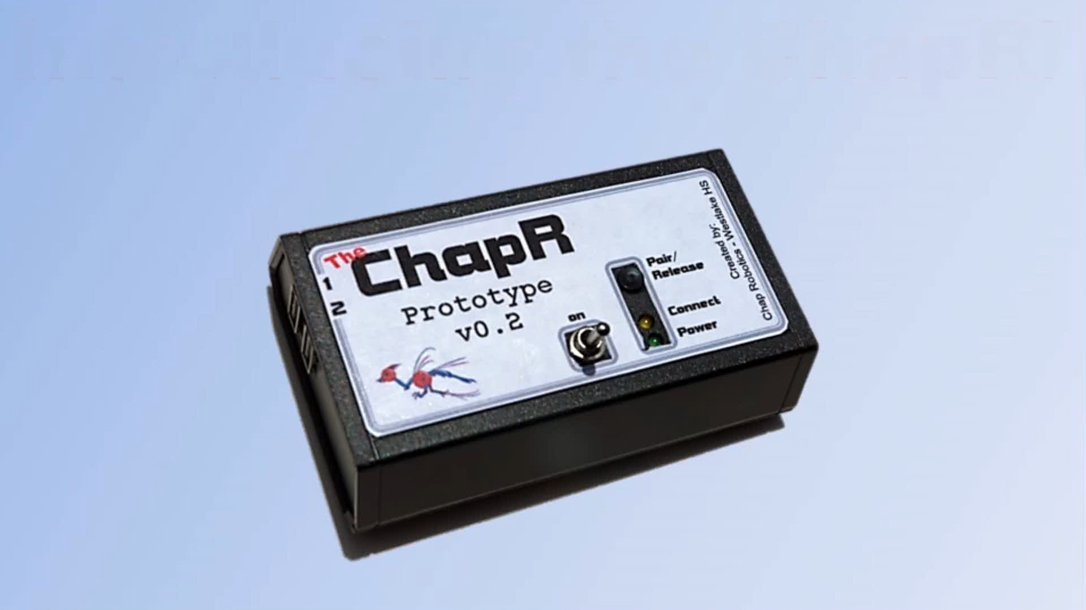

Slide 4
The Team
Rachel Gardner - the project manager, original website content designer, and programmer for the ChapRTM. Rachel makes sure everything is done more or less on time and writes the code for the ChapRTM. She also created (and unfortunately acted in) the commercial for the ChapRTM
Ben Gorr - the hardware specialist, ChapRTM manufacturer and original designer of the circuit board. Ben trains the new members of the team in soldering, and works on the hardware for the new models of the ChapRTM
Akshay Prakash - the marketing and customer relations manager for the ChapRTM. He manages the orders when they come in and works to spread awareness of our product.

Slide 5
The Journey
The Steps of Our “Start-Up”

Slide 6
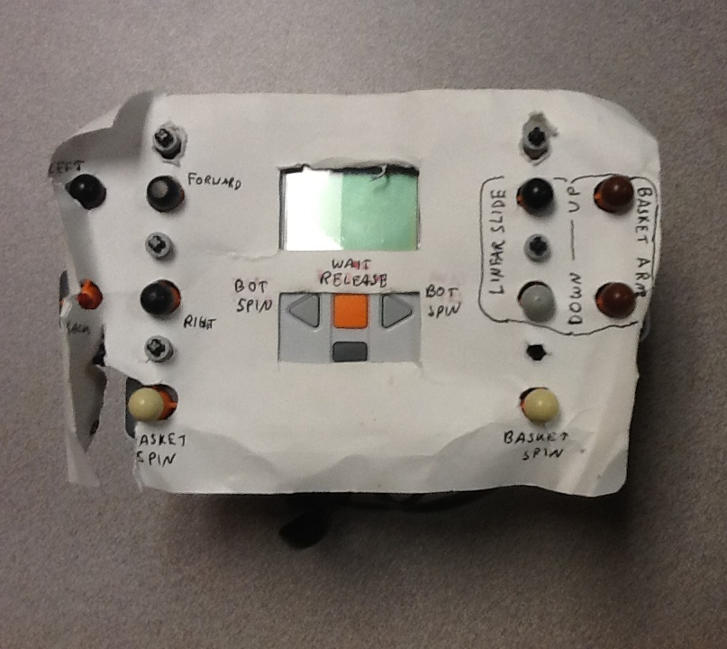
v0.0 – The Inspiration

Slide 7
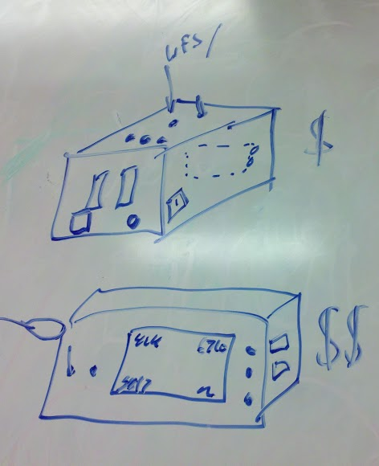
Product Development
*FTC 2 Joystick Control
- Bluetooth
- no PC
- easy to use
- battery (rechargeable? monitor LED?)
- existing brick and software
- full-field range
- low lag
- waitForStart() release
- teleOp remote start
- changeable battery
- field upgrade-able (cable to computer or file on USB)
- companion website with FAQs and tutorials

Slide 8
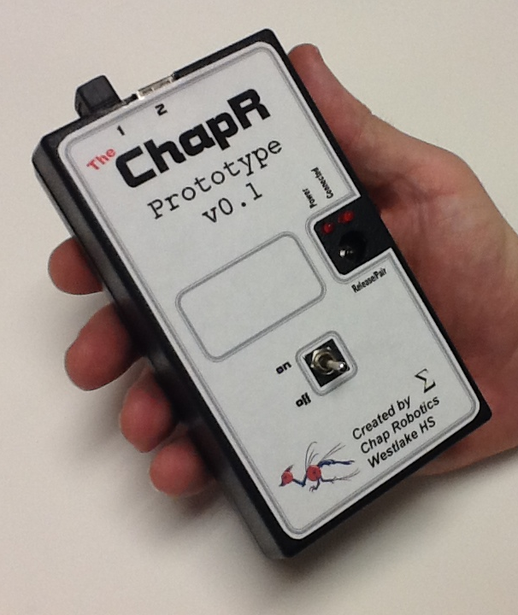
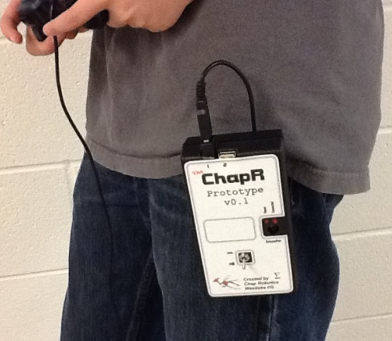
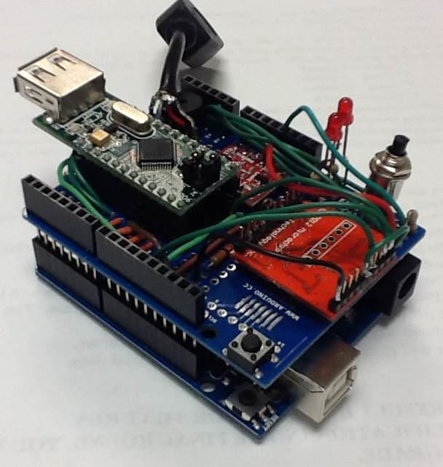
v0.1 – Arduino Uno and Shield

Slide 9
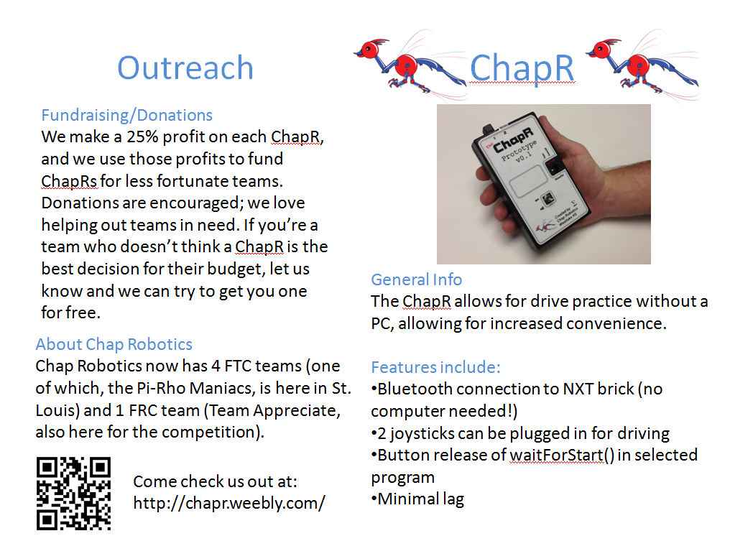
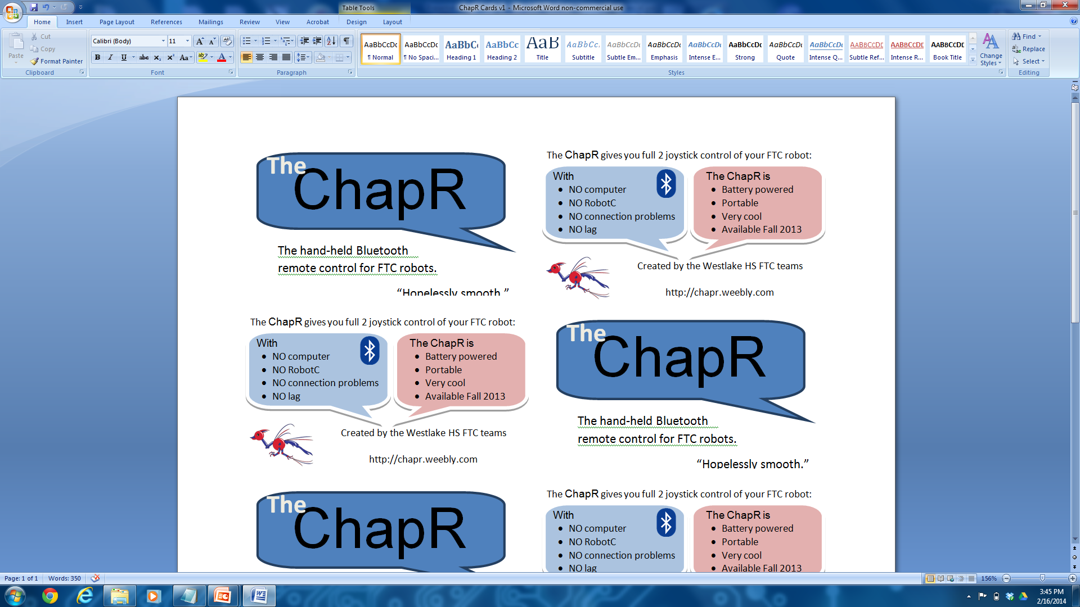
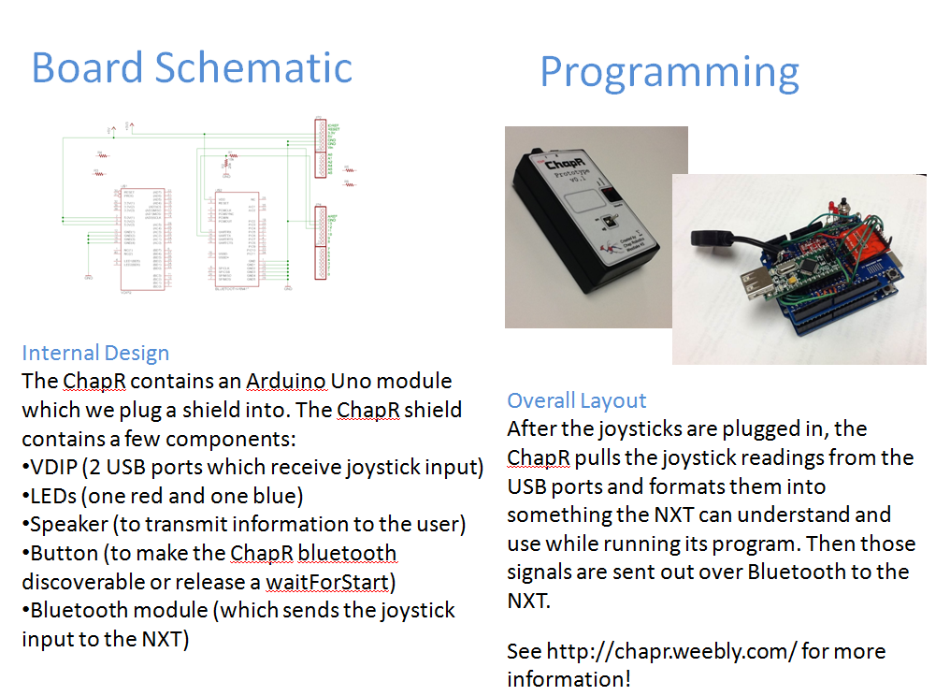
Market Analysis

Slide 10
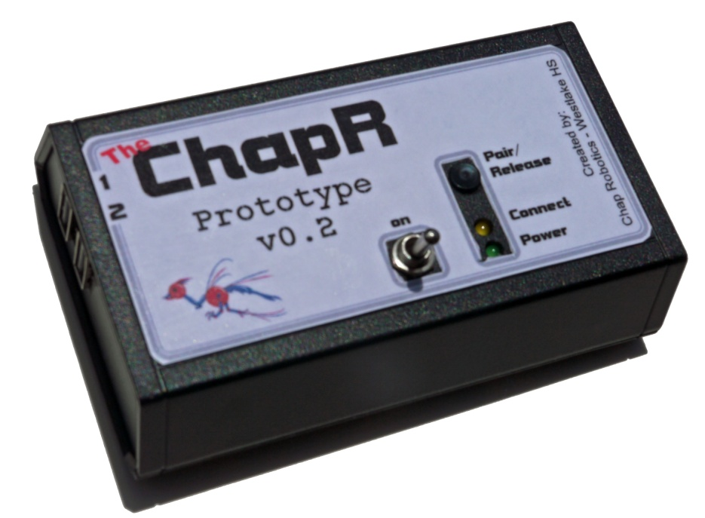
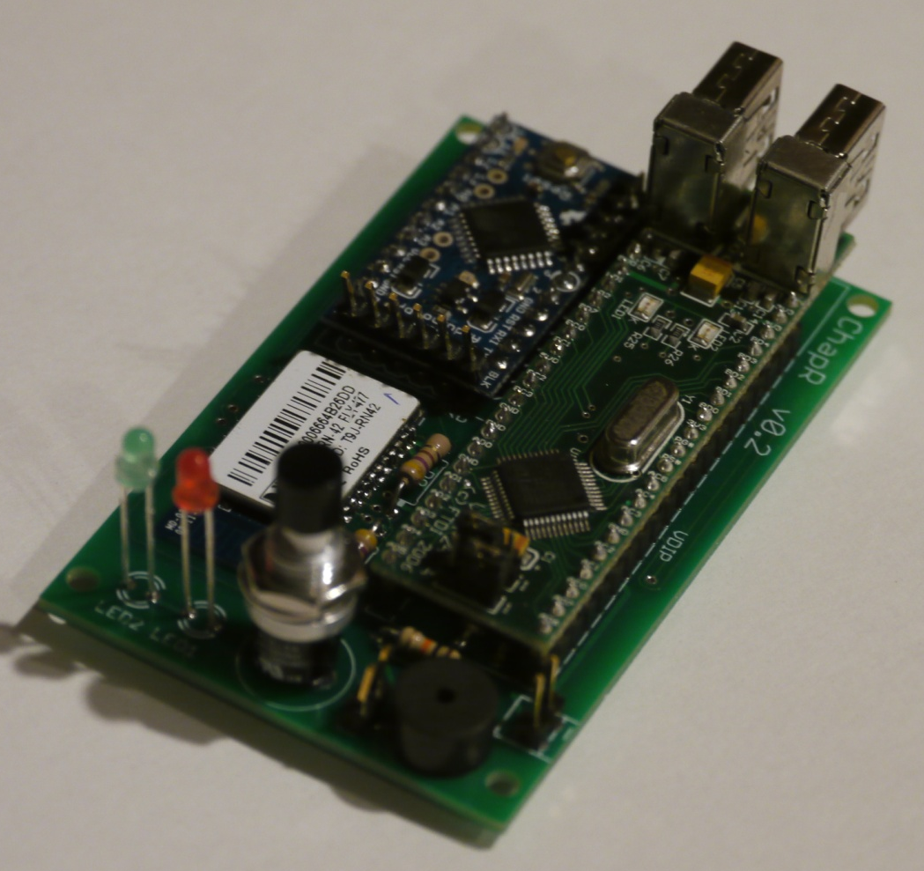
V0.2 - Custom PCB

Slide 11
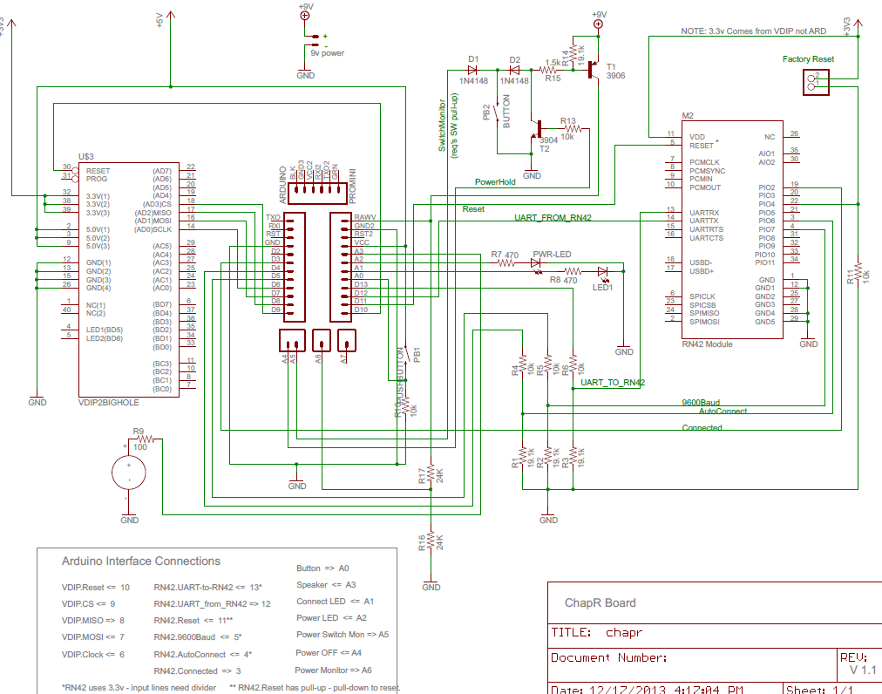
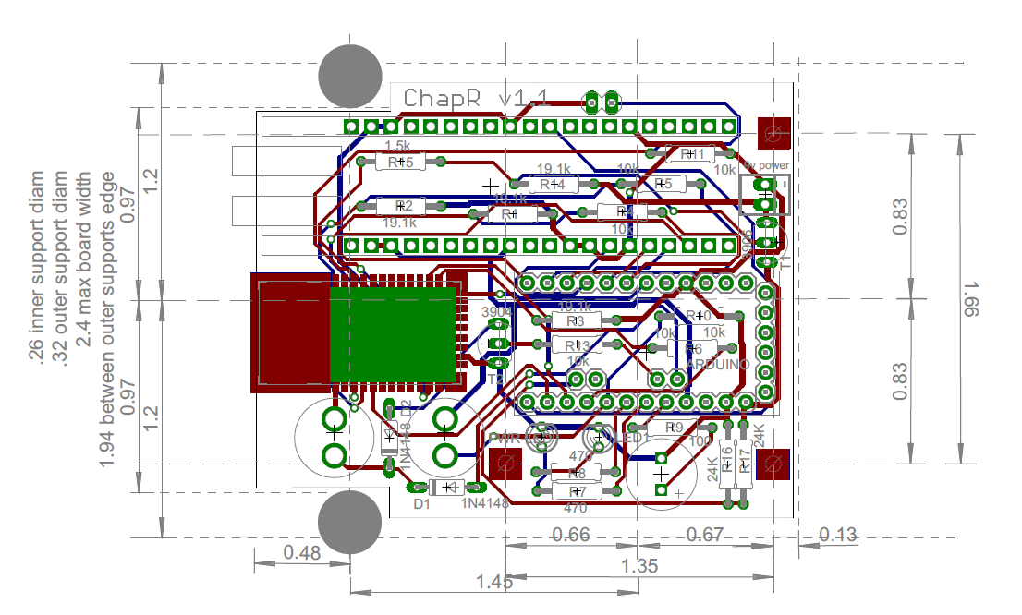
Custom PCB

Slide 12
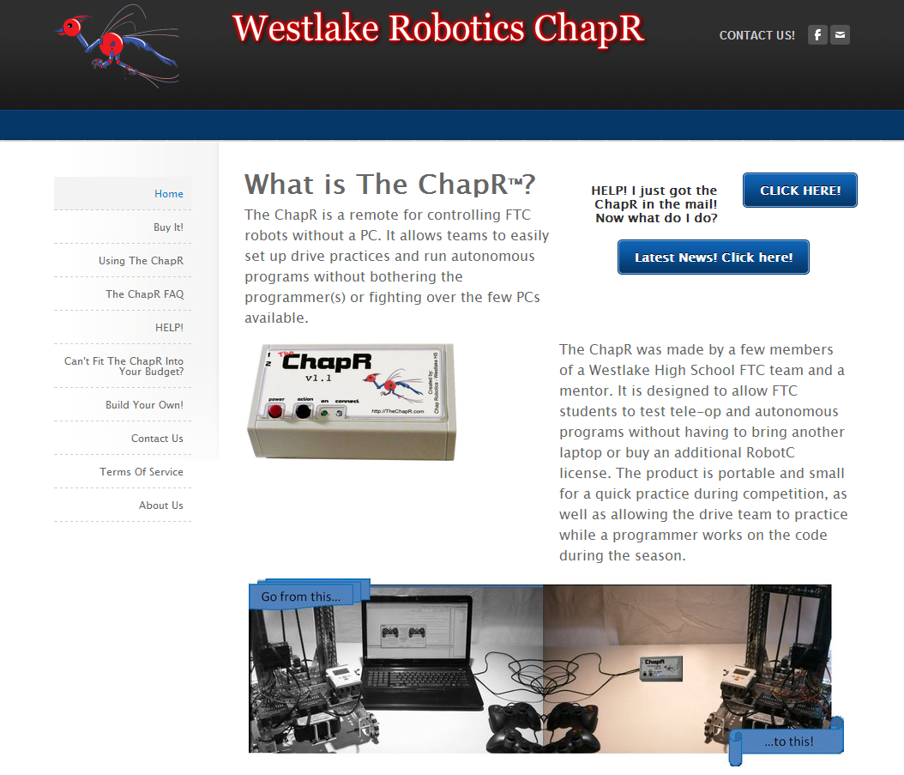
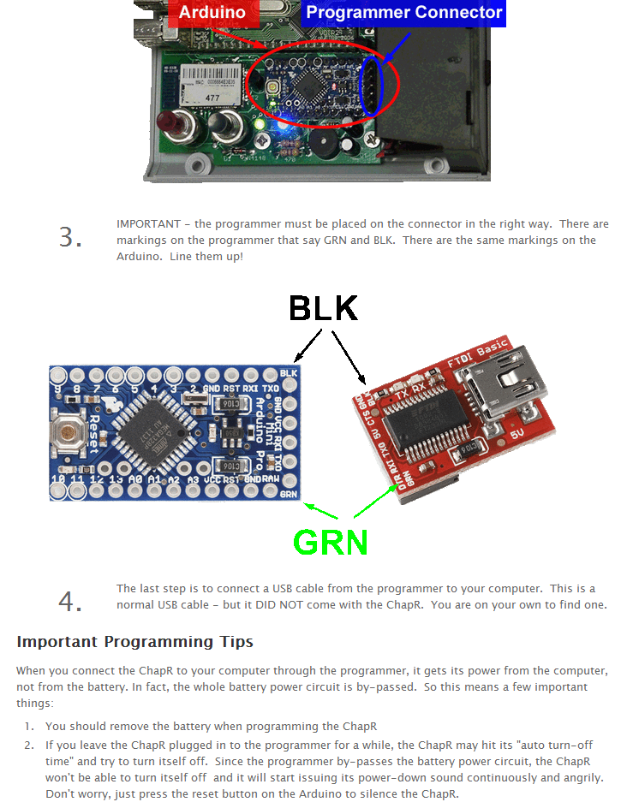
Website Progress

Slide 13
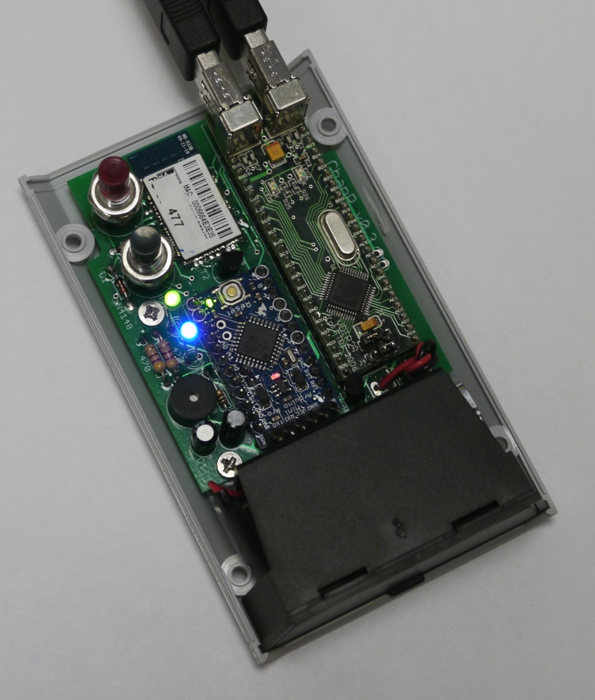
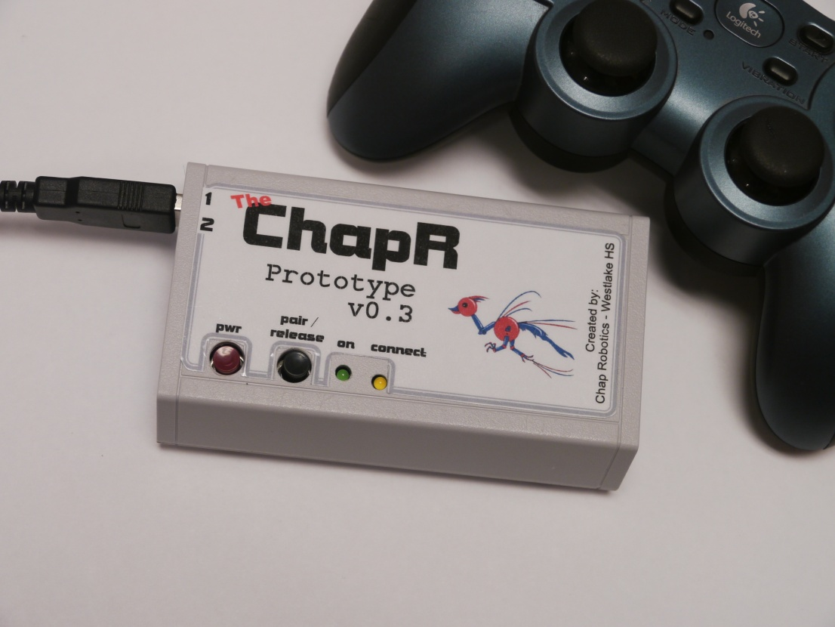
v0.3 – Updated Case and Board

Slide 14
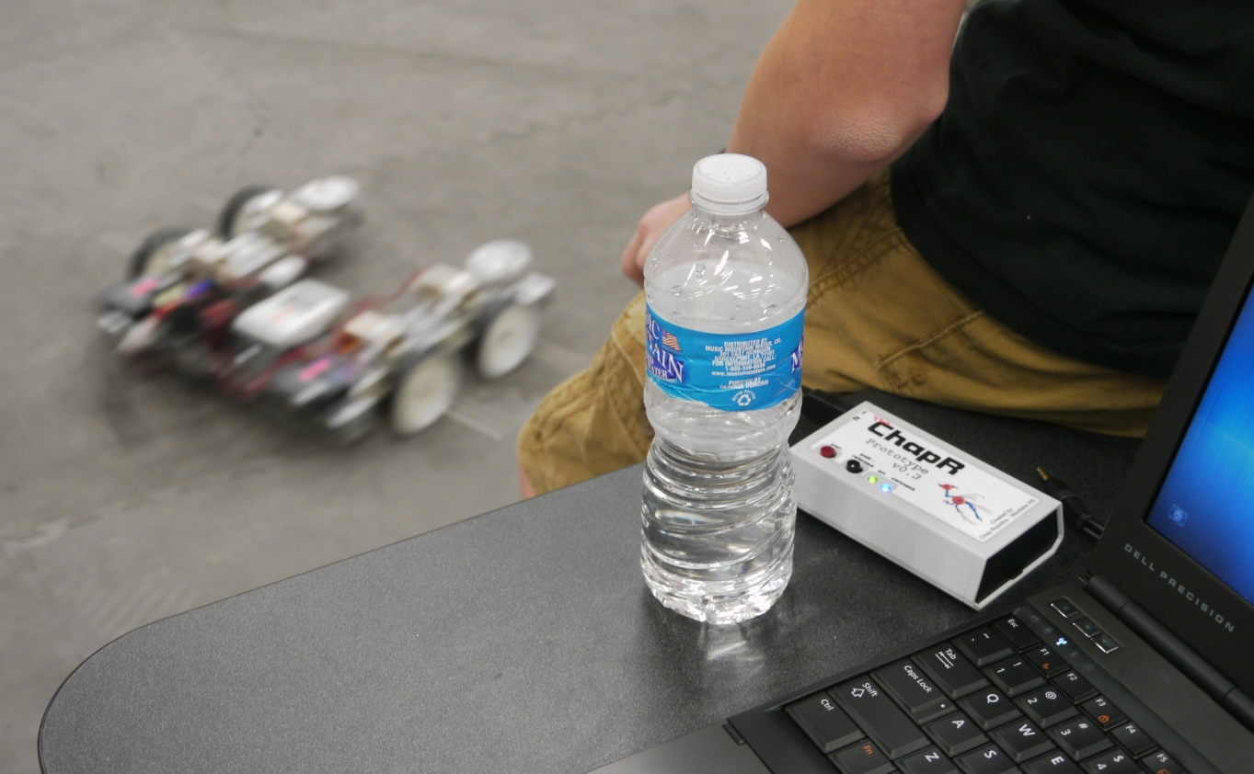
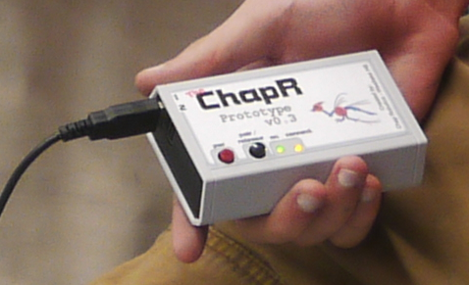
Beta Testing
“Congrats on developing such an amazing and nifty product!”
“All of our teams were just dying to get their hands on one”

Slide 15
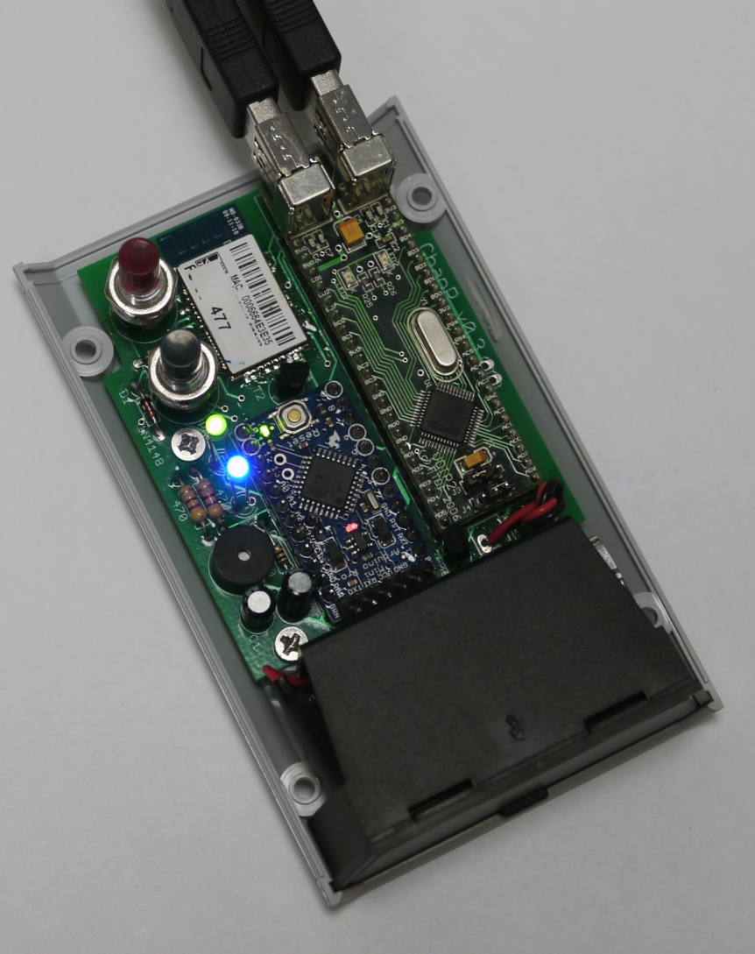
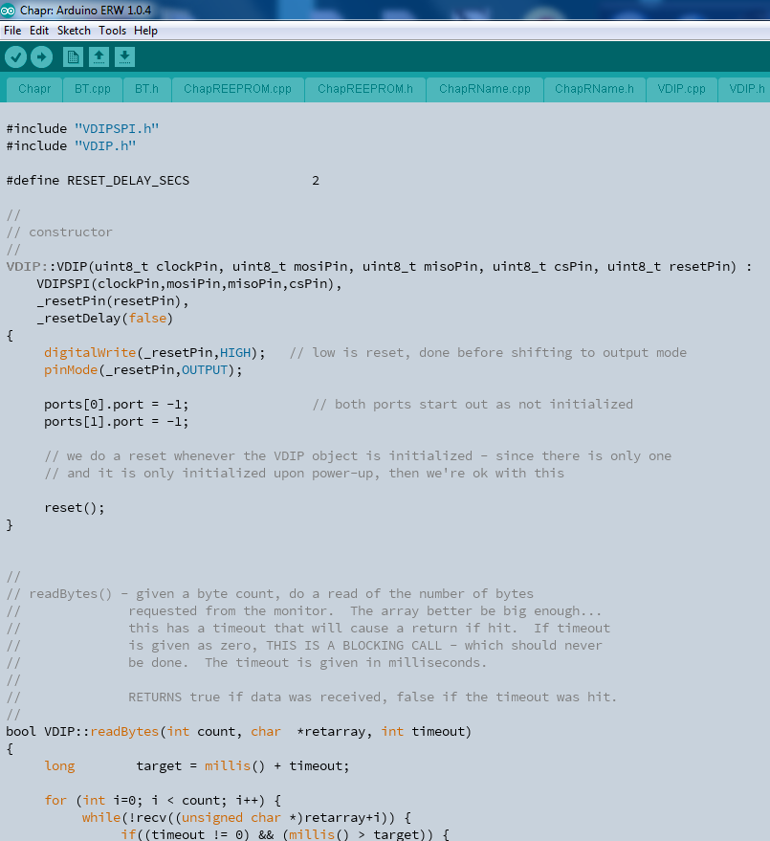
v1.0 – Release version

Slide 16
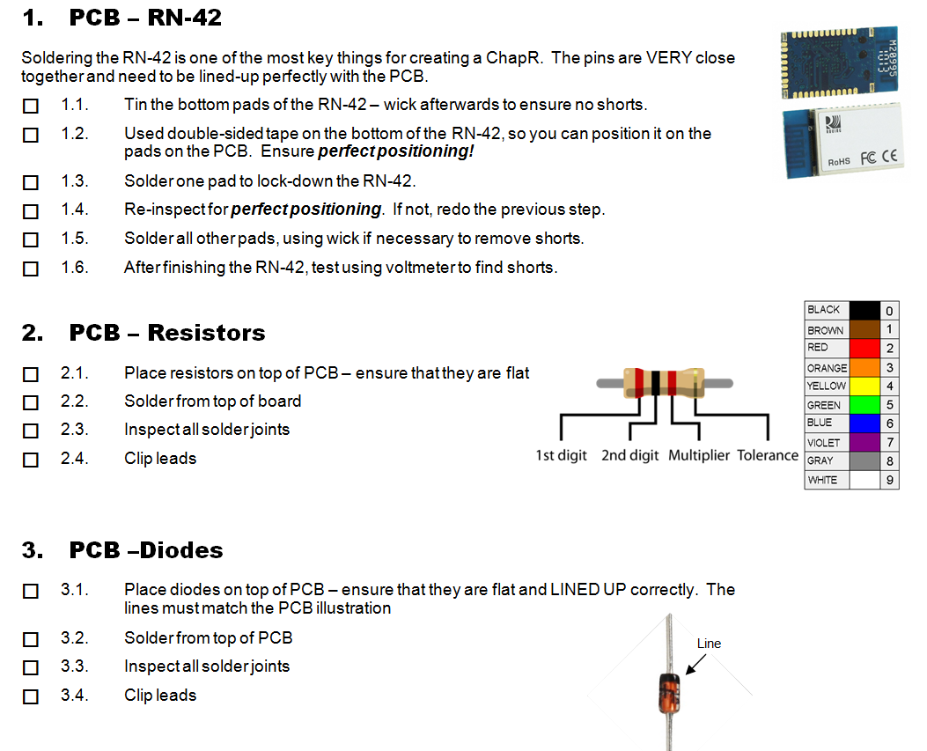
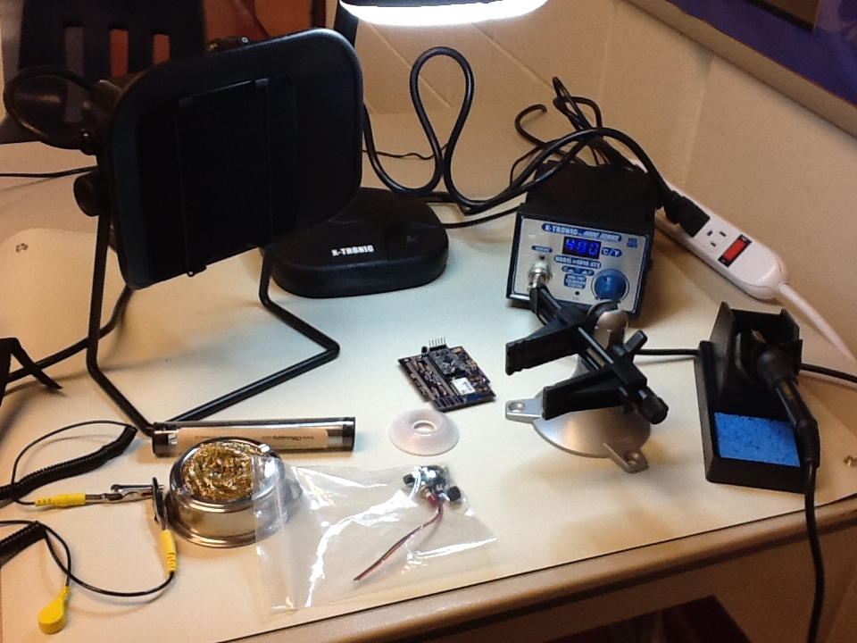
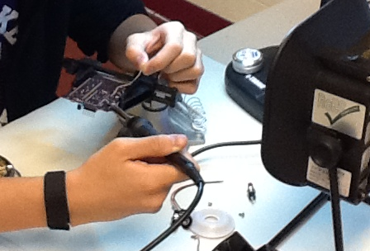
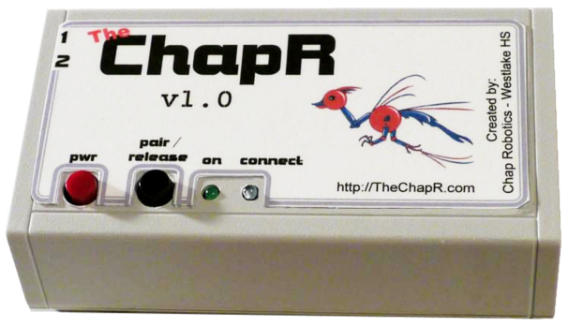
Manufacturing

Slide 17
Business Model
4th ChapR is free for a team in need!
$75 at-cost value, $100 total and $10 for shipping

Slide 18
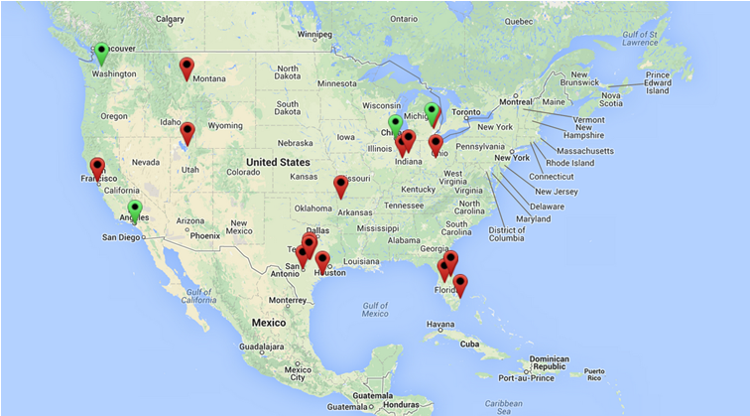
ChapRs Sold: 26
ChapRs Made: 38
Free ChapRs: 4
$110 per ChapR (including shipping)
$100 per Kit (including shipping)

Slide 19
What Now?
1 year into development, we now want to expand our market to educators and hobbyists as well as robotics teams of other competitions
Further products:
Wifi ChapR
Field control system replacement
Chap Research – program to allow other students the same opportunity for innovation

